Slide 1
Disease Prediction Using Machine Learning and Face Recognition Methods
Narae Lee, Georgetown University
Summer Intern at Greenwood Genetic Center
Mentor: Dr. Chin-Fu Chen, Greenwood Genetic Center
Summer 2017

Slide 2
Facial Recognition: The Question
Can a genetic disease be diagnosed from a picture of a face?
Traits: race, age level, gender, etc.
Pretty easily distinguishable by humans (in most cases)
Can a computer distinguish these traits?
How accurately?
How about less obvious traits?
Presence of a genetic disease?

Slide 3
Facial Recognition: Introduction
Step 1: Detecting Faces
Brightness gradients
Histogram of Oriented Gradients (HOG)
Approach invented by N. Dalal and B. Triggs, 2005
Find area most similar to generic face HOG

Slide 4
Facial Recognition: Introduction
Step 2: Encoding Faces
Let the computer generate a 128 measurement encoding
Arbitrary to humans
Deep Convolutional Neural Network to tweak which 128 measurements are generated
Approach developed by F. Schroff, D. Kalenichenko, J. Philbin, 2015

Slide 5
Facial Recognition: The Process
Python library ‘face_recognition’ developed by A. Geitgey performs steps 1 and 2
Step 3: Waikato Environment for Knowledge Analysis (WEKA) to train classifiers
Accepts .arff format
Traits: age, gender, race, disease, etc.
How do the encodings correlate with these traits?
After training, classifiers can predict traits from the encodings

Slide 6
Facial Recognition: The Process
Search for Database
Familiarize with DB
Collect Info from DB
Extract 128 Number Encodings
Compile Relevant Information
Sufficient # of photos
Unique subjects or duplicates?
Useful metadata
Organization of information
Location of metadata
File paths of picture files
Using Python, for each subject:
Isolate metadata
Open picture files
face_recognition Python library
For each picture file, extract array of 128 numbers
Combine encoding data, race/age/ID etc. metadata
Comma-separated values format (.csv)
Transform into .arff file
Analyze using WEKA
Compare results
Discard irrelevant columns
Insert headers
Convert between file types as necessary
Try various classifier methods
Clustering
Attribute Selection
Which methods performed better?
Which age groups? races?
Why?

Slide 7
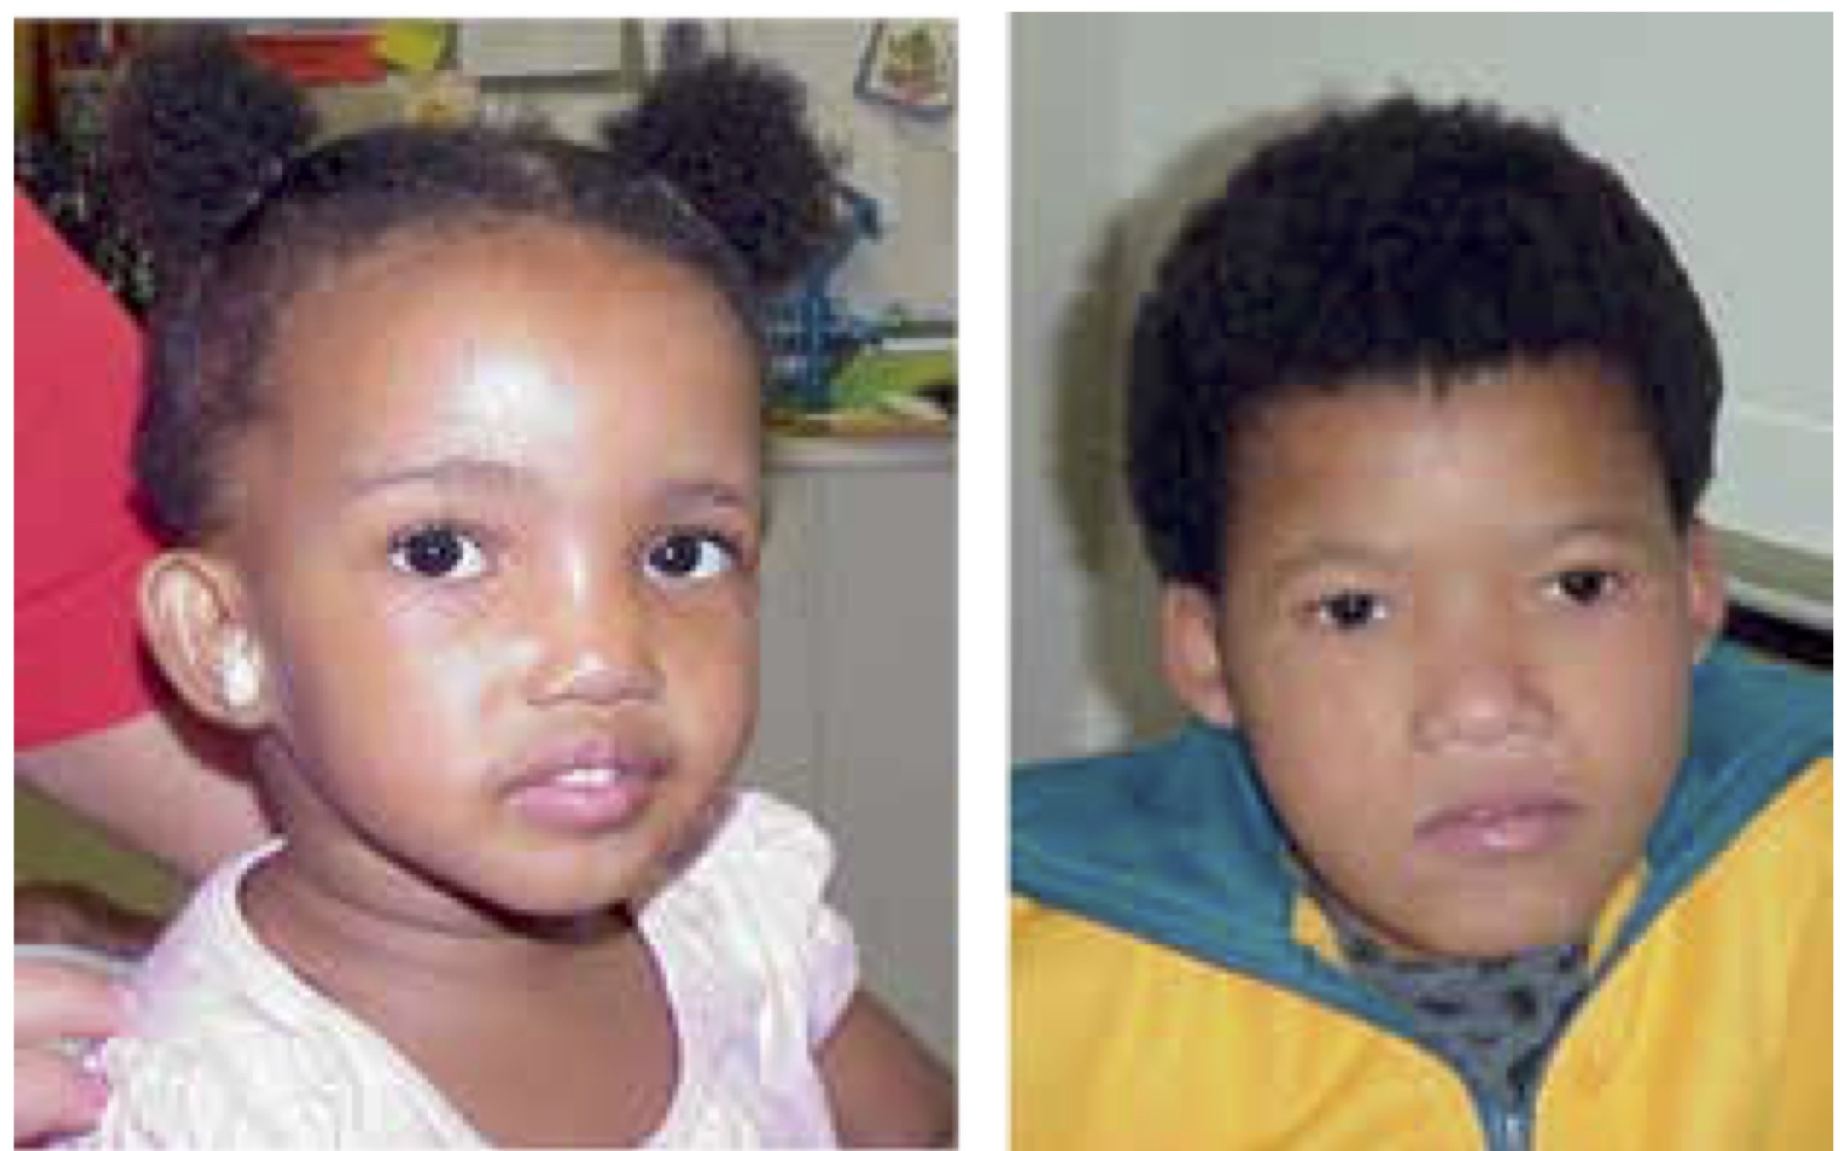
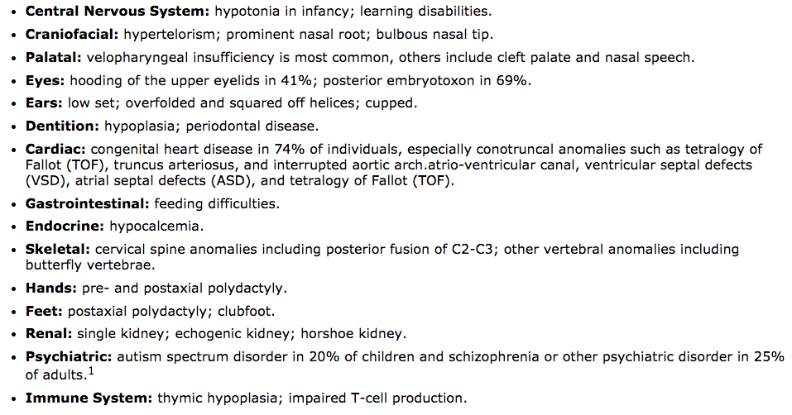
Disease Prediction (Intro)
Disease studied: 22q11.2 Deletion Syndrome
Genetic malformation
Affects facial structure, eyes, nose, mouth, but also multiple organs
The earlier it is caught, the better
Can our machine learning scheme predict whether a baby or child has this disease just from a picture?

Slide 8
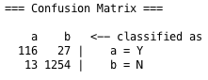
Disease Prediction (Methods)
~150 pictures of people with 22qDS
Pictures from the other databases as the control group—no disease
Separate into “bins” by race and age
Age bins:
Baby/toddler: 0-3 years
Child: 4-12 years
Teen/adult: 13 years and up
Race bins:
Black/African-American
Asian
Latino
All combined:
All ages and races included

Slide 9
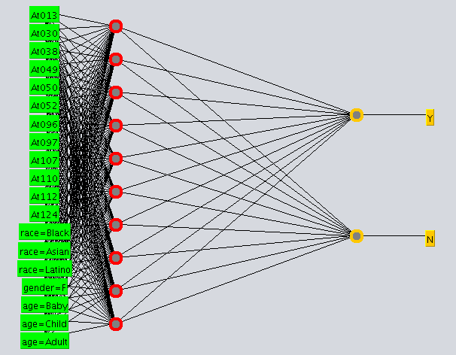
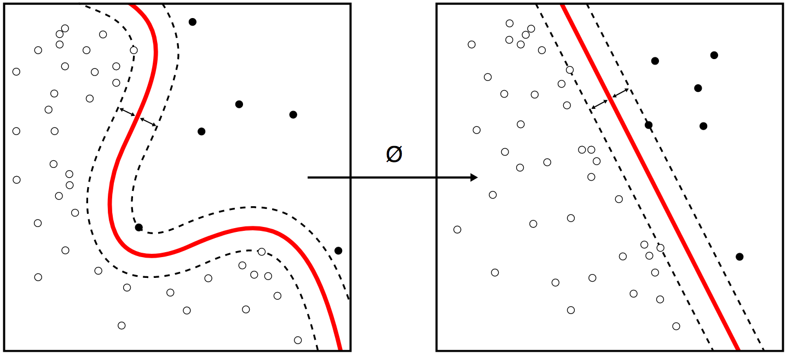
Disease Prediction (Methods)
Support Vector Machine (SVM)
Multilayer Perceptron (neural network)
By Alisneaky, svg version by User:Zirguezi - Own work, CC BY-SA 4.0, https://commons.wikimedia.org/w/index.php?curid=47868867

Slide 10
Disease Prediction (Results)
Support Vector Machine (SVM)
Less accurate
More accurate
 | Asian | Black | Latino
0 to 3 | 0.948
4 to 12 | 0.963
13 + | 0.938
 | Asian | Black | Latino
0 to 3 | 0.948 | 0.913 | 0.980
4 to 12
13+
 | Asian | Black | Latino
0 to 3 | 0.959
4 to 12
13+
Multilayer Perceptron (neural network)
 | Asian | Black | Latino
0 to 3 | 0.941
4 to 12 | 0.964
13 + | 0.948
 | Asian | Black | Latino
0 to 3 | 0.944 | 0.926 | 0.980
4 to 12
13+
 | Asian | Black | Latino
0 to 3 | 0.960
4 to 12
13+
*All tests using 10-fold cross validation to prevent overfitting

Slide 11
Disease Prediction (Results)
Age bins:
All similar
0 to 3 has highest precision/recall
Race bins
Asian race
Lowest precision/recall
Due to too little training data
Black race
Lowest accuracy (still over 90%)
High precision/recall
Latino race
Highest accuracy, precision, recall

Slide 12
Conclusion and Future Directions
Viable tool, once further developed
Collect more data to refine (including other races)
Expand for more facially recognizable diseases, including Down Syndrome, Klinefelter Syndrome, Angelman Syndrome, etc.
Meant as a supplement to doctors for diagnosis, not a replacement

Slide 13
Acknowledgements
Dr. Chin-Fu Chen, mentor
Dr. Gilliean Lee
Greenwood Genetics Center

Slide 14
References
Geitgey, A. (2016, July 24). Modern Face Recognition with Deep Learning. In Machine Learning is Fun! (Part 4). Retrieved from https://medium.com
Dalal, N., & Triggs, B. (2005). Histogram of Oriented Gradients for Human Detection. Thoth. Retrieved from http://lear.inrialpes.fr
Kazemi, V., & Sullivan, J. (2014). One Millisecond Face Alignment with an Ensemble of Regression Trees. KTH Royal Institute of Technology School of Computer Science and Communication. Retrieved from http://www.csc.kth.se/
Schroff, F., Kalenichenko, D., & Philbin, J. (2015). FaceNet: A Unified Embedding for Face Recognition and Clustering. The Computer Vision Foundation. Retrieved from http://www.cv-foundation.org/
Atlas of Human Malformation Syndromes in Diverse Populations (2016, Oct. 19). National Human Genome Research Institute. Retrieved from https://research.nhgri.nih.gov
Kruszka, P., et. al. (2017). 22q11.2 Deletion Syndrome in Diverse Populations. American Journal of Medical Genetics.
De Decker, R. (2016). Predicted v. real prevalence of the 22q11.2 deletion syndrome in children with congenital heart disease presenting to Red Cross War Memorial Children’s Hospital, South Africa: A prospective study. The New Millennium.
Witten, I. H., & Frank, E. (2005). Data Mining: Practical Machine Learning Tools and Techniques. San Francisco, CA: Elsevier.
Face Picture Databases Used:
ColorFERET (Facial Recognition Technology) https://www.nist.gov/itl/iad/image-group/color-feret-database
LFW (Labeled Faces in the Wild) http://vis-www.cs.umass.edu/lfw/
FDDB (Face Detection Dataset and Benchmark) http://vis-www.cs.umass.edu/fddb/
IMDb-Wiki Dataset https://data.vision.ee.ethz.ch/cvl/rrothe/imdb-wiki/

Slide 15
Disease Prediction Using Machine Learning and Face Recognition Methods
Narae Lee, Georgetown University
Summer Intern at Greenwood Genetic Center
Mentor: Dr. Chin-Fu Chen, Greenwood Genetic Center
Summer 2017

